Slide 1

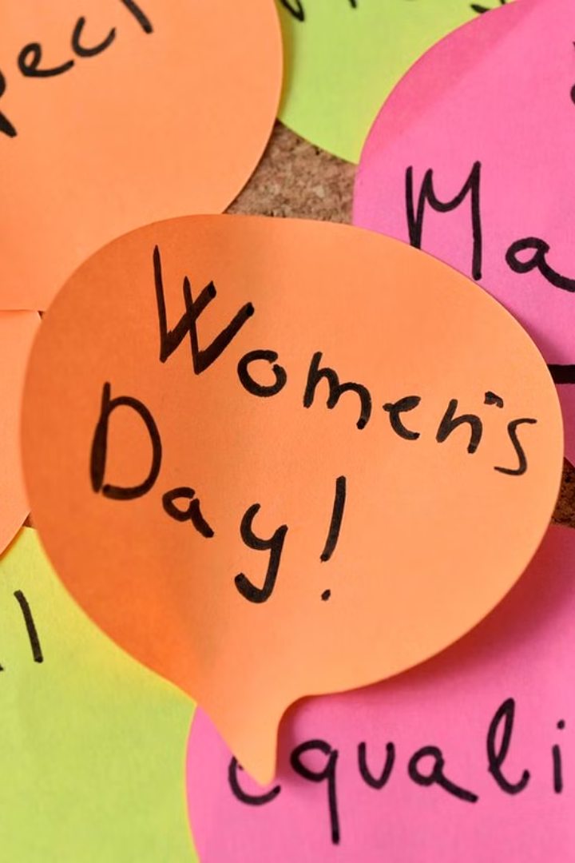

Introduction to International Women's Day
International Women's Day is a global day celebrating the social, economic, cultural, and political achievements of women. It's a day to recognize and support the call for gender equality.
by Manisha Kumari

Slide 2

History and Significance of International Women's Day
1
Origin of the Day
Founded in 1911, it emerged from the social unrest and political movements advocating for women's rights.
2
Recognition of Achievements
Over the years, it has become a symbol of the fight for equality and women's empowerment.
3
Global Significance
It's a day to commemorate the social, economic, cultural, and political achievements of women worldwide.

Slide 3

Theme for This Year's International Women's Day
1
"Choose to Challenge"
The theme highlights the importance of challenging gender bias and inequality to create an inclusive world.

Slide 4
Achievements and Progress in Women's Rights
Legal Reforms
Political Representation
Economic Empowerment
Over the years, significant progress has been made in terms of women's legal rights and protections.
More women are entering political offices, contributing to a more gender-balanced governance structure.
Women's participation in the workforce and leadership positions has seen positive growth.

Slide 5




Challenges and Obstacles That Women Still Face
Gender-Based Violence
Gender Pay Gap
Cultural Barriers
Women continue to face various forms of violence and abuse based on their gender.
Unequal pay and limited opportunities still exist for women in various industries.
Deep-rooted societal norms and traditions pose obstacles to gender equality.

Slide 6

Celebrating Women's Achievements Around the World
Diversity in Accomplishments
Social and Humanitarian Work
Inspiring Leadership
Women leaders have been catalysts for change, inspiring and empowering others.
Women have excelled in fields ranging from science and technology to arts and sports.
Many women have made significant contributions to social causes and humanitarian efforts.

Slide 7



Calls to Action and Ways to Support Gender Equality
Educational Initiatives
Activism and Advocacy
Economic Empowerment
Supporting educational programs that promote gender equality and women's rights.
Encouraging active participation in movements supporting gender equality.
Creating opportunities for women's economic independence and entrepreneurship.

Slide 8
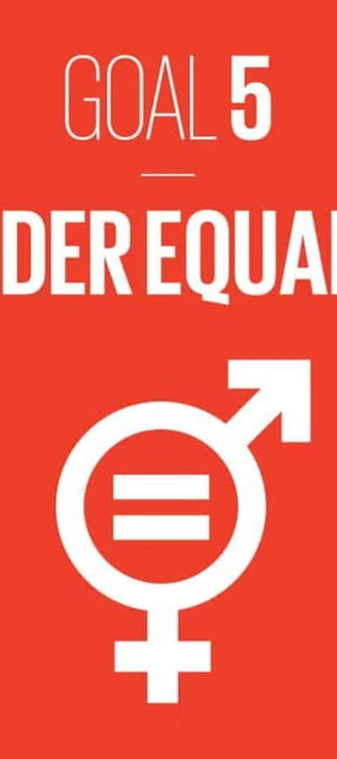
Conclusion and Future Goals for International Women's Day
1
Progress into the Future
Continuing to strive for a world where women and girls enjoy equal rights, opportunities, and representation.

Slide 9


